Slide 1
RACY Shoe Store
Modern Retail operations: Leveraging Database Technology
Notes:
Chris

Slide 2




Meet our RACY Shoe Store Database Team:
Rohit Akole
Allison Lund
Christopher Vandenburgh
Yashas Guddada Sreenivas
Notes:
Chris

Slide 3
Topics for Discussion
Database purpose and benefits relative to retail
Data flow diagram
Database interactions
Information retrieval
Data interpretation
Data modification
Lessons learned
Notes:
Chris

Slide 4
Pre-database Problems: Database Enhancements:
Missed sales opportunities
Difficulty tracking inventory
Poor customer insights
Limited store comparability
Weak employee oversight
Disorganized product tracking
Comprehensive sales tracking
Streamlined inventory control
Customer history and loyalty
Store sales analysis
Effective employee management
Return, shipment, and supplier tracking
Notes:
Chris

Slide 5
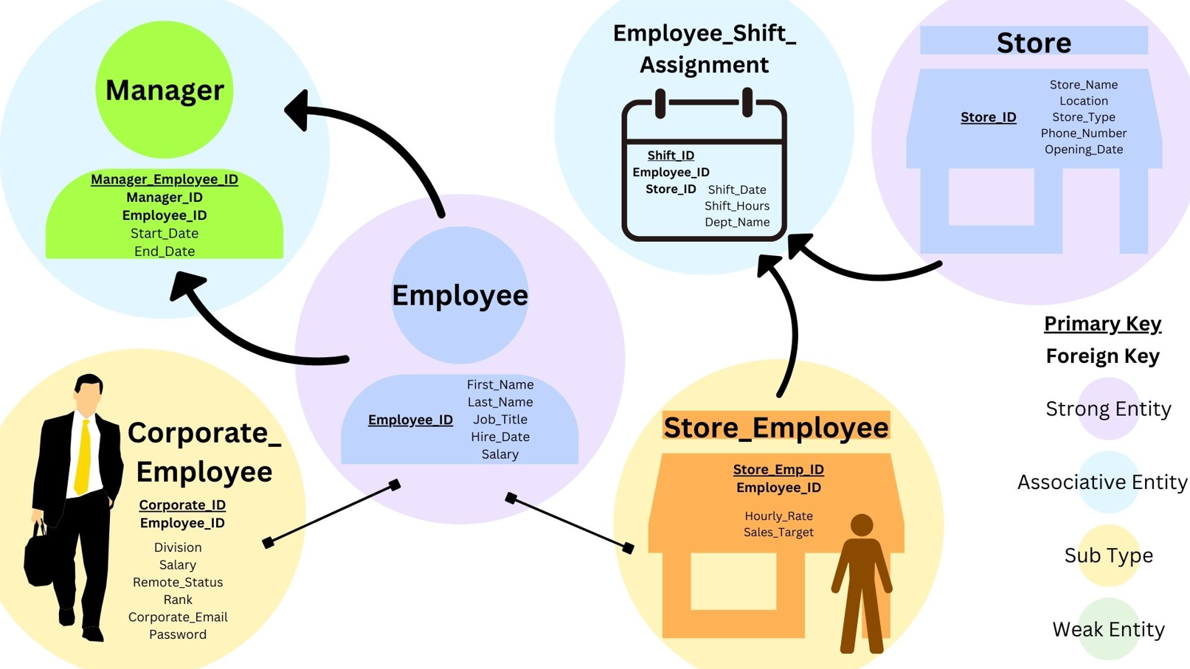
5
Notes:
Allison

Slide 6
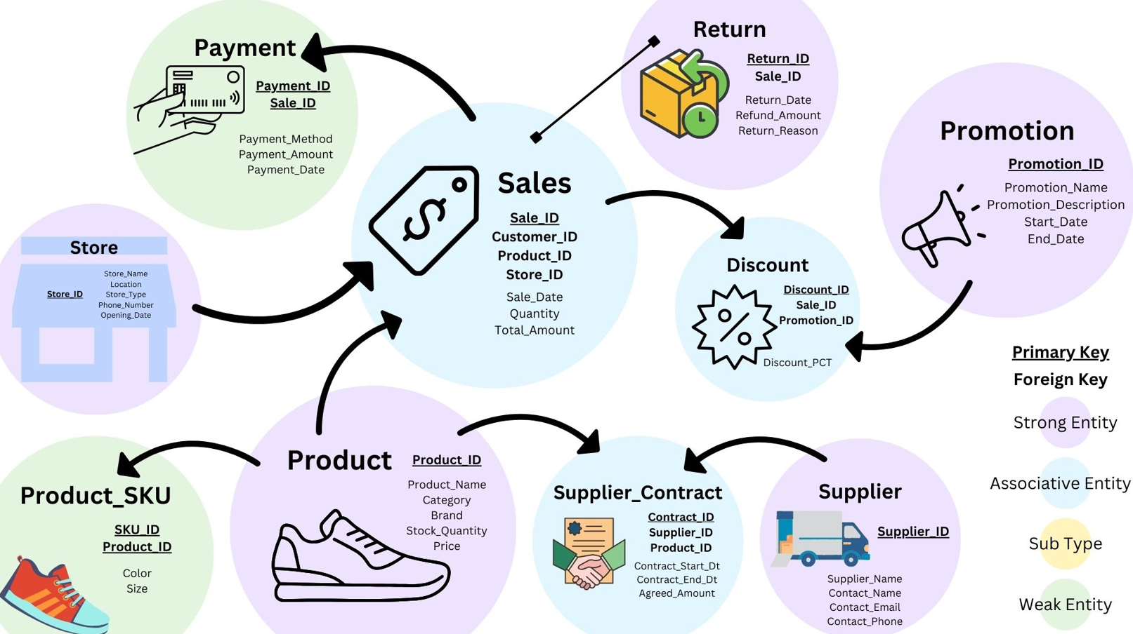
6
Notes:
Allison

Slide 7
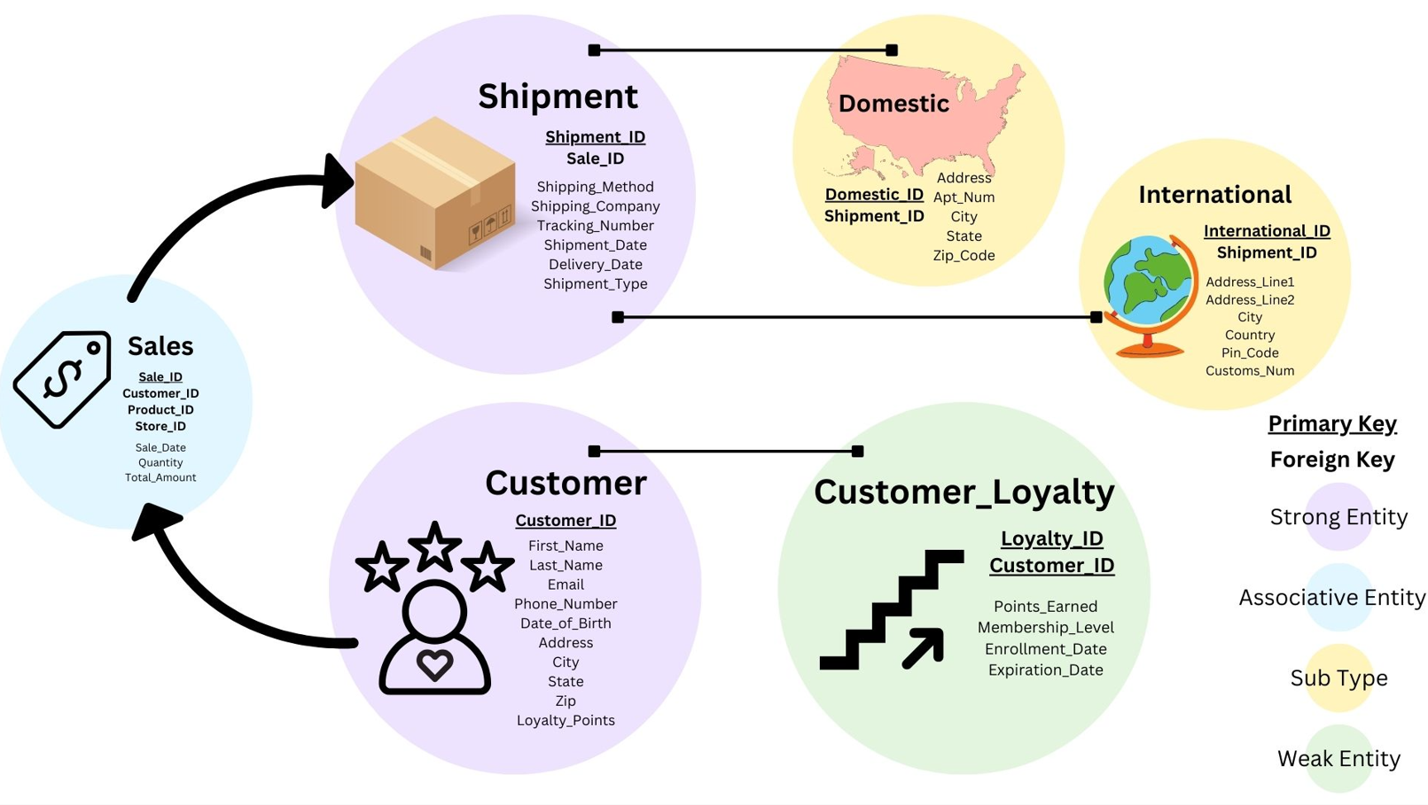
7
Notes:
Allison

Slide 8
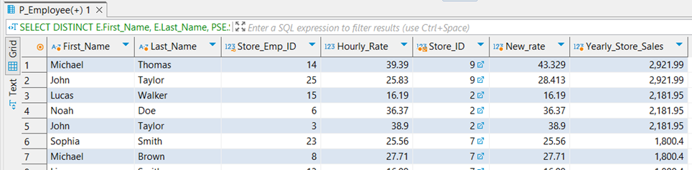
Report 1: Top Yearly Sales Store Award
Compare yearly sales across stores
Reward employees at the top store
Encourage employees to work as a team
Notes:
Rohit
10% increment to the employees with the Top Sales amongst all stores

Slide 9
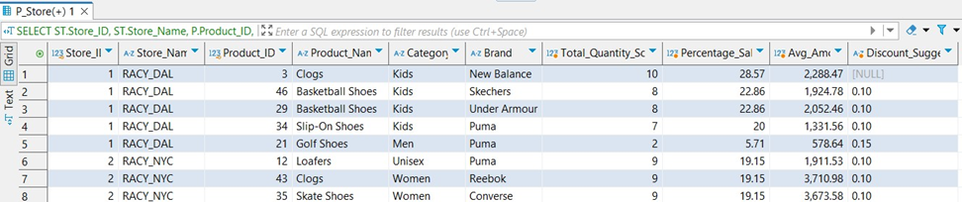
Report 2: Discounting Low Volume Products
Product performance by store
Discount slower moving products
Tailor marketing strategies
Refine product placements
Notes:
Rohit
Quantity sold per product per store
Percentage of total sales by each product in the store
Average Total Amount spent on a product
Discount Suggestions:
3 or less -> 15%
Between 4 and 9 -> 10%
10 or more -> No Discount

Slide 10
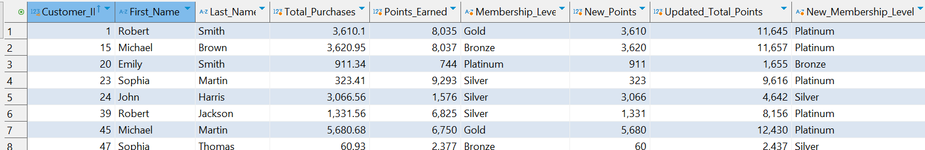
Report 3: Rewarding Loyal Customers
Reward repeat customers
Assign customer membership levels
Add points for every purchase
Notes:
Rohit
Assumed that the customer already have existing points
We added more points per $ spent
Membership Level:
0 – 2000 Bronze
2001 – 5000 Silver
5001 – 8000 Gold
8001 Or More Platinum

Slide 11
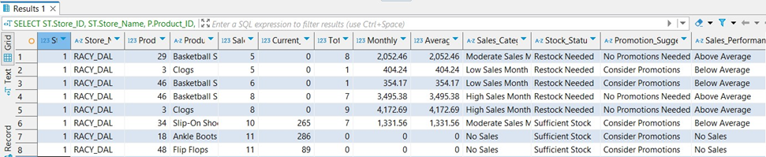
Report 4: Sales Insights
Manage inventory
Suggest products for promotion
Benchmark performance
Categorize sales
Notes:
Yashas

Slide 12
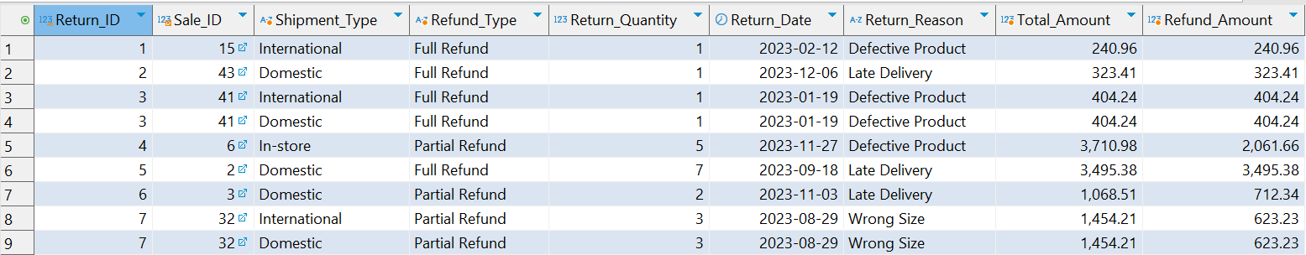
Report 5: Refund Analysis
Consolidate return data
Track return purpose
Check if returned is domestic or international
Add returned items back to inventory
Determine refund amount
Notes:
Yashas

Slide 13
Lessons Learned and Future Plans
Challenges faced:
Determining business rules to generate accurate relationships within ERD
Ex. Store Employees & Employee Shift Assignment
Translating our physical ERD to SQL
Needed to tweak some properties
Sharing the database with all group members
Recommended changes:
Add a weak entity to stores with more information
Include more details for types of products from suppliers
Notes:
Yashas

Slide 14
Thank You for Your Time
Questions?
Notes:
Yashas

